Slide 2
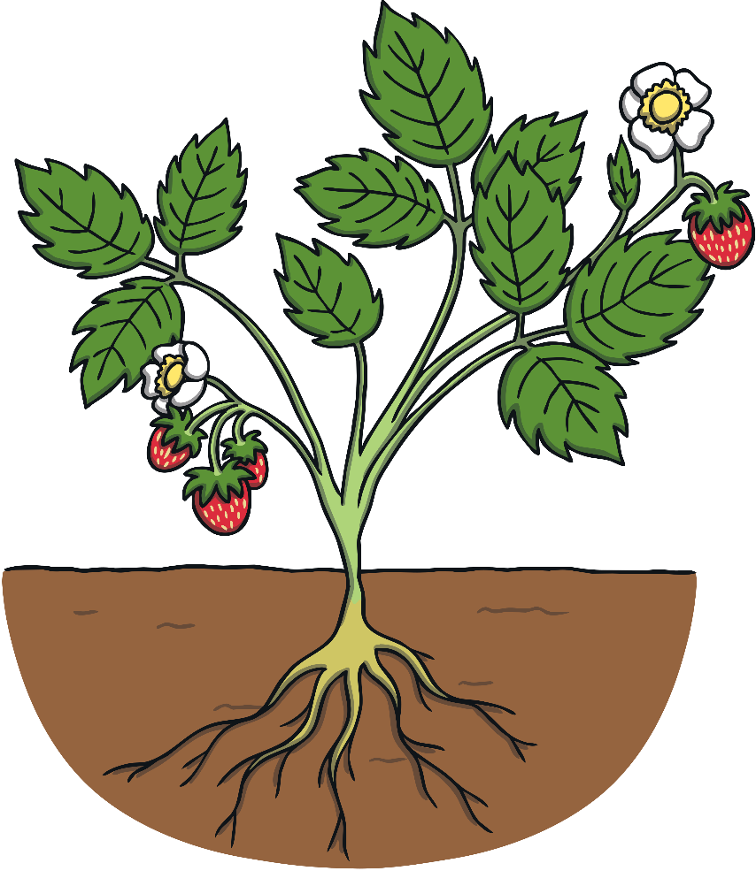
Parts of a Plant
Plants have different parts to them, just like you. We have different body parts such as arms, legs and a mouth. A plant has different parts too and they all do different jobs.
We can eat parts of some plants.

Slide 3
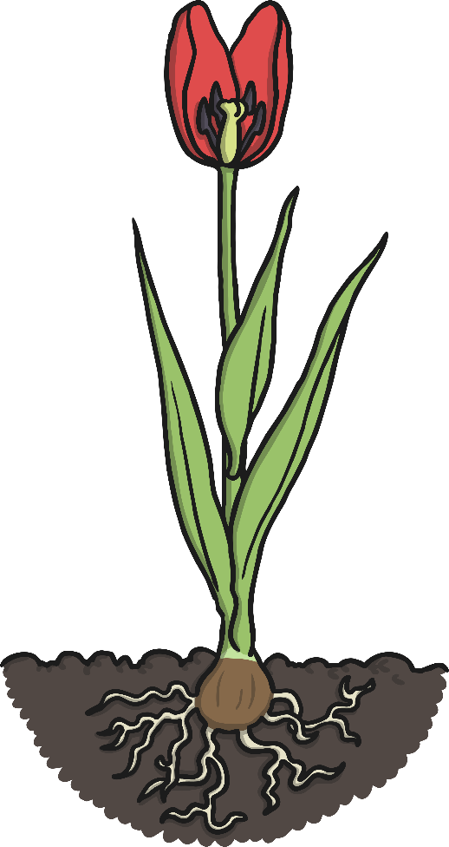
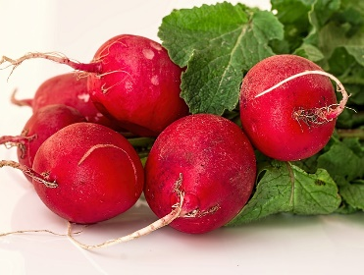
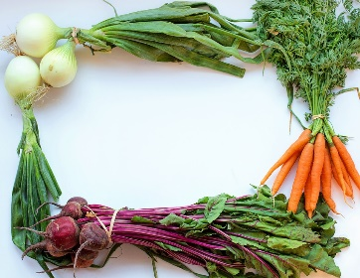
Roots
The roots of a plant anchor it in the ground. Without roots, a plant would fall over.
Roots also take in nutrients and water from the soil.
Here are some root vegetables that we can eat.
Can you name them?
roots

Slide 4
Stems and Leaves
The stem helps to support the plant and keep it upright.
Water and food are taken up from the roots and transported through the stem.
stem
Leaves are very important as they make food for the plants.
Leaves are made to catch the sunlight, as plants need sunlight to make food.
leaves
This process is called photosynthesis.
Leaves come in all sizes and shapes.

Slide 5
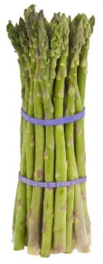
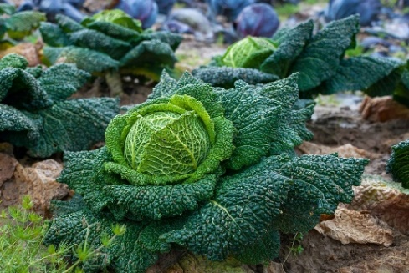
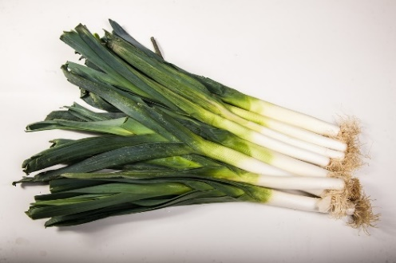
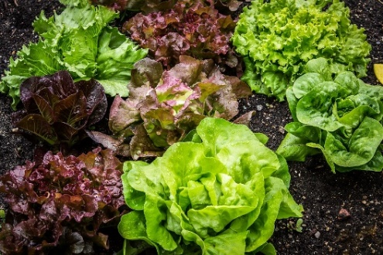
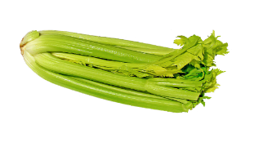
Stems and Leaves
Here are some stem and leaf vegetables that we can eat.
Can you name them?
Can you think of any others?

Slide 6
Flowers
Flowers look pretty and come in lots of different colours.
They can also smell lovely.
flower
These colours and smells are important because they attract bees, birds and butterflies that pollinate the plant. The plant will then produce seeds or fruit.

Slide 7
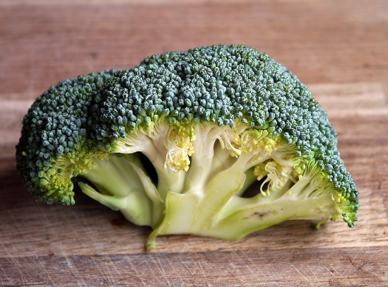
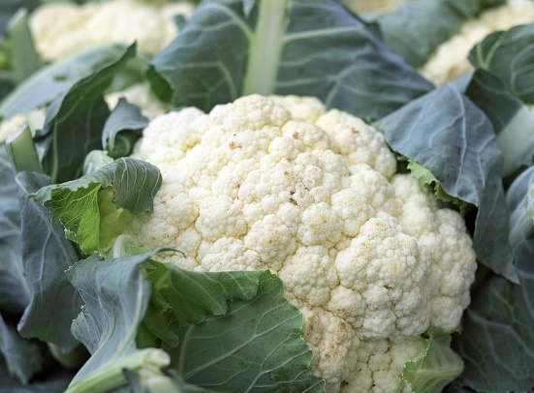
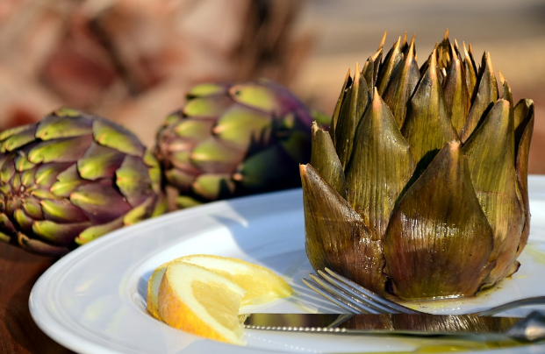
Flowers
Here are some flower vegetables that we can eat. Can you name them?

Slide 8
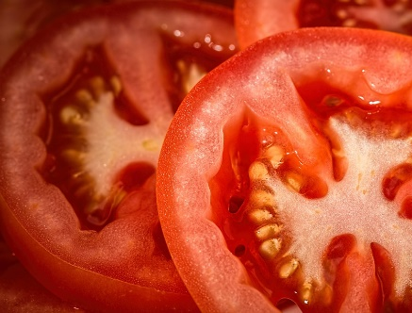
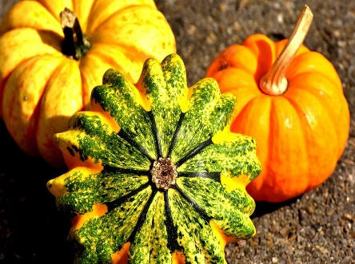
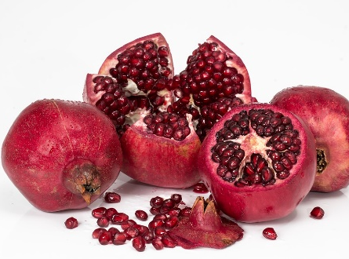
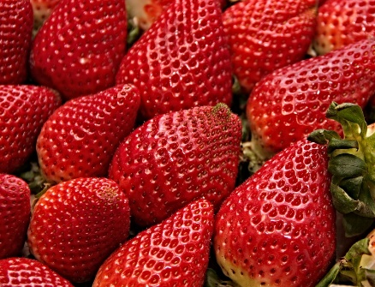
Fruit
Many plants have fruit to carry and spread their seeds.
Some of the foods we might think are vegetables are actually fruits.
If the food has seeds, it is a fruit. The seeds might be on the inside or outside of the fruit.

Slide 9
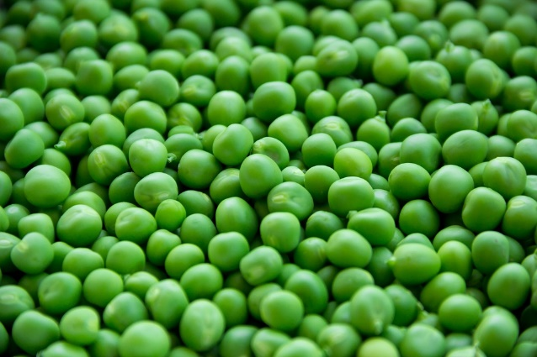
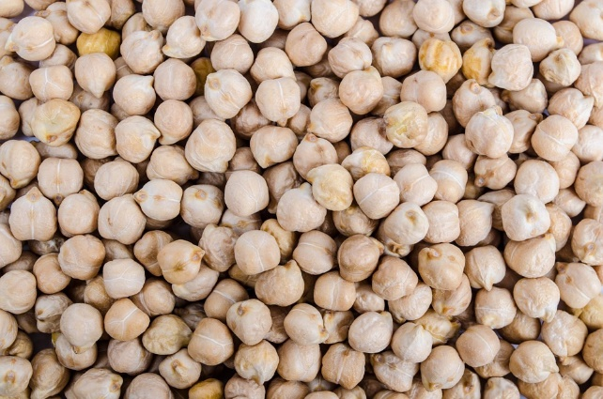
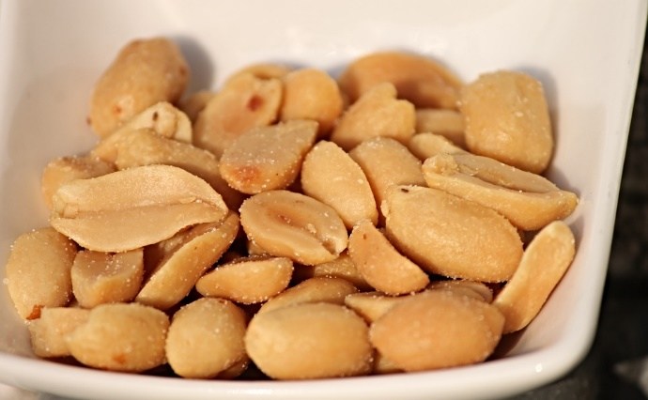
Seeds
Some of the foods we eat are the seeds of plants.
Can you name them?

Slide 10
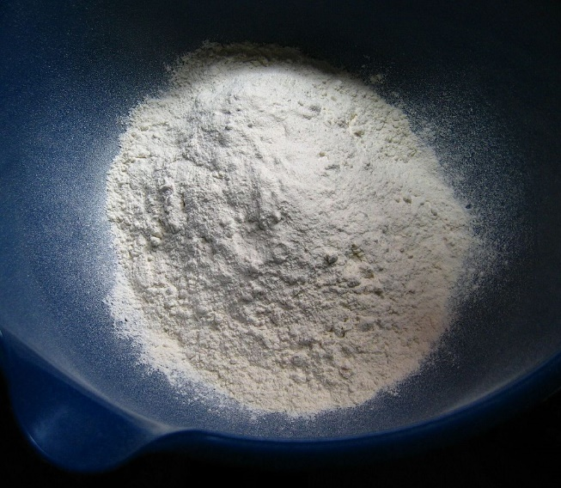
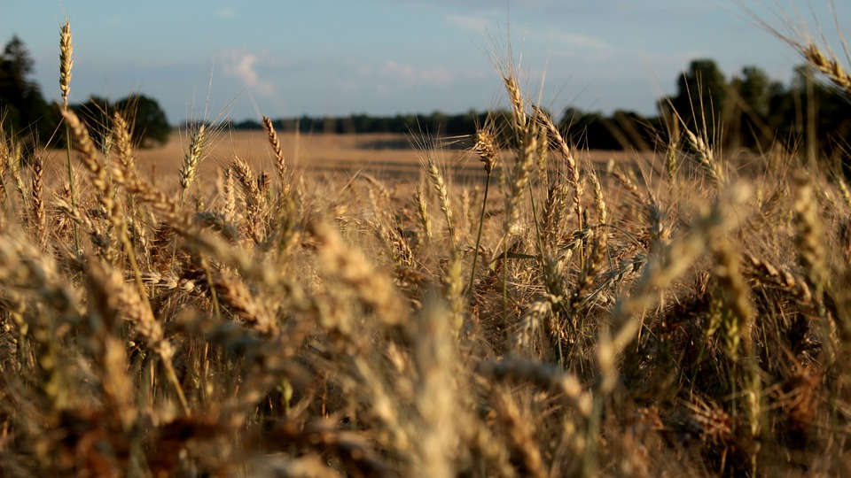
Seeds
Grains and cereals are also the seeds of plants.
This is wheat. It grows in fields. It is ground into flour.
What can flour be used to make?

