Slide 1


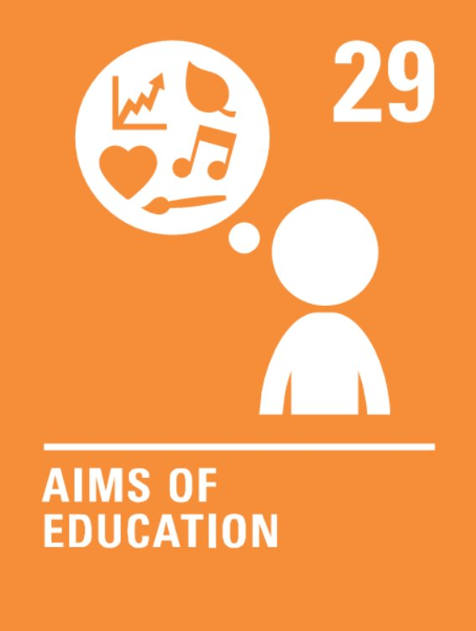




Coverage Summer 1 2024
Week | News Story | Focus Question | British Value Link | Protected Characteristics | UN Article
8th April | Following announcements regarding the health of both King Charles III and Kate, the Princess of Wales, the Royal Family has released statements requesting privacy. | Should everyone be allowed to lead a private life? | Rule of Law | Age
15th April | A new artwork, from the mysterious street artist Banksy, appeared in North London overnight in March. It has since been defaced with white paint. | What does art mean to you? | Mutual Respect and Tolerance | Religion or Belief
22nd April | Scottish runner, Jasmin Paris, has become the first female runner to complete what is thought by many to be the world's toughest race, the Barkley Marathons in Tennessee, USA. | Can you learn to persevere? | Individual Liberty | Sex
29th April | Stef Reid, a former Paralympian medal-winner who represented Canada and Great Britain, is asking Nike and other sportswear companies to start selling individual trainers to single-leg amputees. | How can shops make sure everyone feels represented? | Democracy | Disability
6th May | A new study from the Journal of Archaeological Method and Theory, using evidence found in northwestern Italy, has found that Neanderthals (an extinct relative of humans) organised their living areas in a similar way to people today. | Can the past help us to learn about modern life? | Individual Liberty | Religion or Belief
13th May | Cambridge University has returned four spears to the descendants of an indigenous community in Australia, who crafted them. | What is your identity? | Mutual Respect and Tolerance | Race
20th May | An all-girls football team has won a league dominated by boys’ teams, after going unbeaten for an entire season. | Is it fair to judge others based on first impressions? | Democracy | Sex
© Picture News 2024

