Slide 1


Christingle

Slide 2
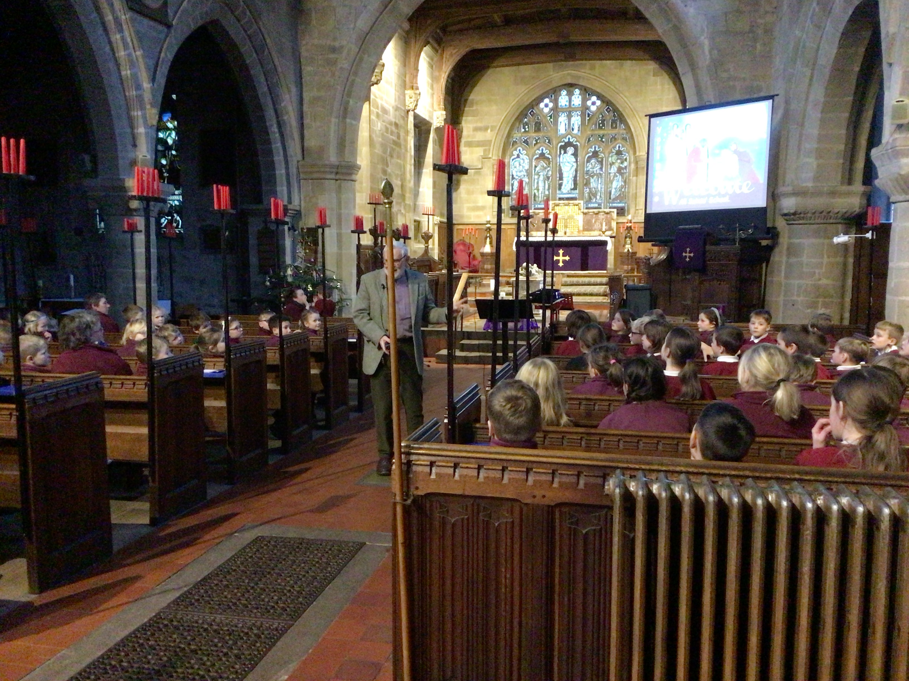
Christingle Services
A Christingle service is a joyful celebration that brings families and communities together to share the light of Jesus and spread a message of hope.

Slide 3
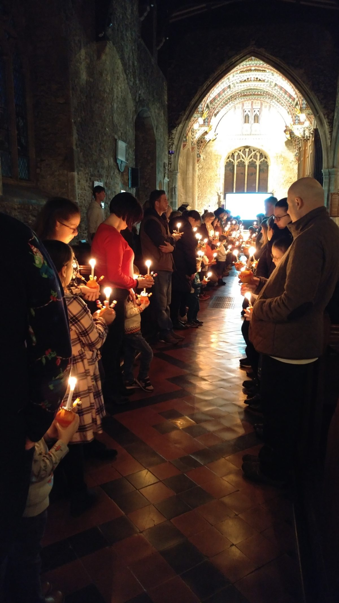
History of Christingles
Christingles date back to 1747, when a minister in a church in Germany gave children a lighted candle with a red ribbon around it.
The first Christingle service held in England in 1968, raised money for the Children’s Society charity.

Slide 4
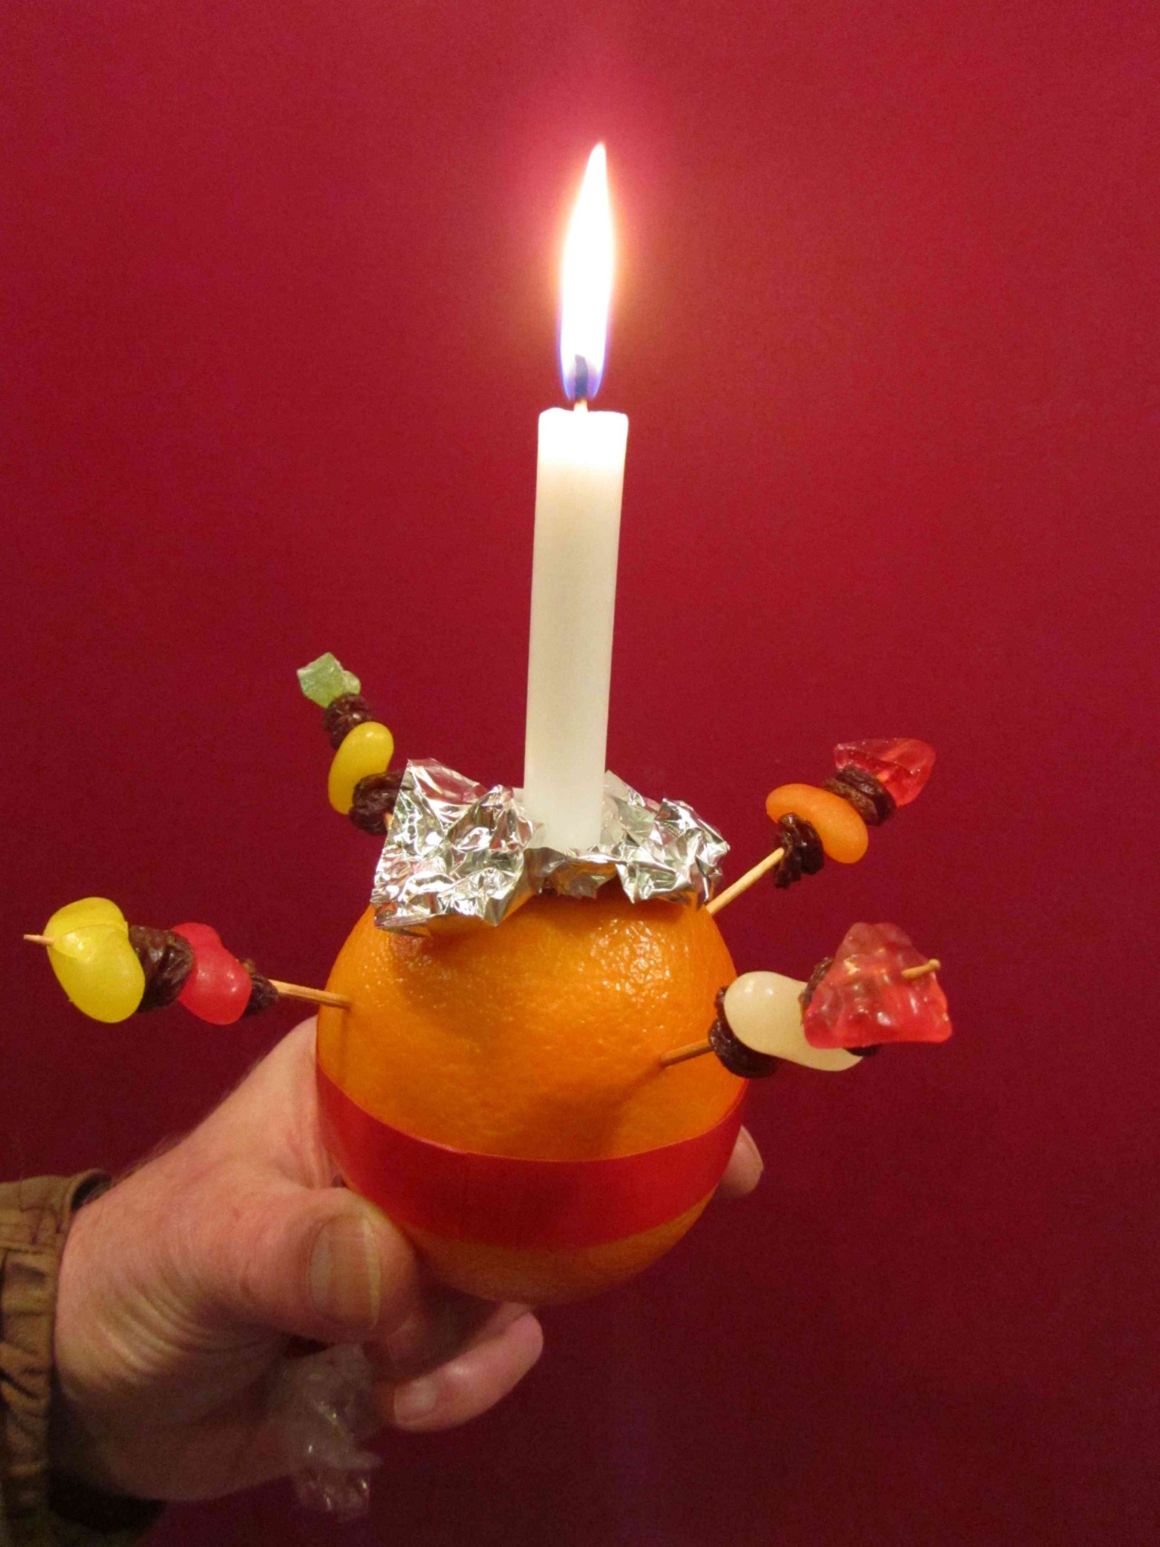
What is a Christingle?
A Christingle is made from an orange, red ribbon, 4 small sticks, dried fruits or sweets and a lit candle.
Christingle means: ‘Christ’s Light’.

Slide 5


The Orange
represents the world

Slide 6
The orange represents the world.
We pray for our world, that men and women, boys and girls can live together peacefully and that there will be no more wars.
We pray for children who are sad and lonely in the world.
Lord, in your mercy,
Hear our prayer

Slide 7
The Orange
How can you make the world a better place for everyone to enjoy?

Slide 8

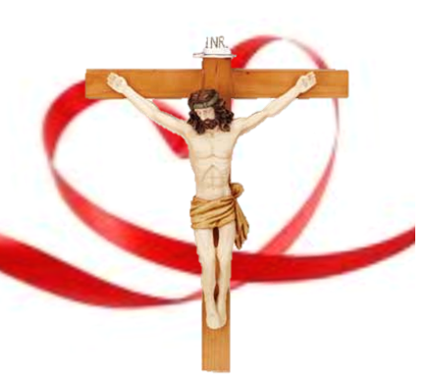
The Ribbon
represents God’s love and Jesus’ blood

Slide 9
The Ribbon
The red ribbon reminds us of Good Friday when Jesus died at Easter time. It is sad when people die, please comfort those who are sad because a relative or neighbour has died, and please look after children whose parents have died.
Lord, in your mercy,
Hear our prayer

Slide 10
The Ribbon
Who is special to you?
Whose love are you grateful for today?

Slide 11

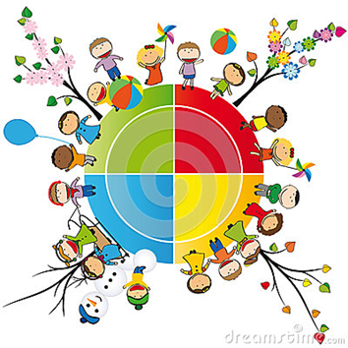
The Fruits and Sweets
represents the
four seasons, the fruits of the earth and God's good gifts.

Slide 12
The Fruits and Sweets
The sweets and fruit on the cocktail sticks remind us that the gifts have come from God.
Thank you for the sun and the rain which make crops grow, we pray for children who are hungry because bad weather has spoiled the food their family were growing.
Lord, in your mercy,
Hear our prayer

Slide 13
The Fruits and Sweets
What is your favourite season?
What is your favourite food?

Slide 14

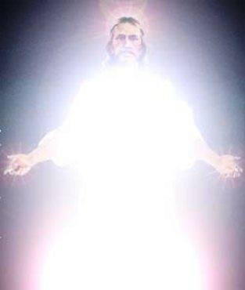
The Candle
represents Jesus, the Light of the World

Slide 15
Jesus said, ‘Shine as lights in the world’.
Jesus, you call us to act justly and with kindness.
We pray for wisdom as we work to make the world a better place.
Lord, in your mercy
Hear our prayer.
The Candle

Slide 16
The Candle
What gives you joy?
How can you make a difference in our world today?

Slide 17
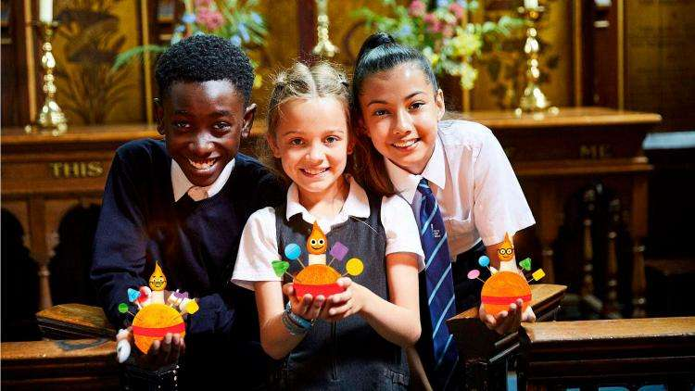
Meaning of Christingle
In the darkness of the world, Jesus came to bring light. Christians believe that Jesus came to make a difference in people’s lives. He came to bring God’s forgiveness and love.

Slide 18
1 Silent night, holy night!
All is calm, all is bright.
Round yon virgin mother and child,
Holy infant, so tender and mild,
Sleep in heavenly peace,
Sleep in heavenly peace!
2 Silent night, holy night!
Shepherds quake at the sight,
Glories stream from heaven afar,
Heavenly hosts sing “Alleluia!”
Christ the Saviour is born,
Christ the Saviour is born.
3 Silent night, holy night!
Son of God, love's pure light.
Radiance beams from thy holy face
With the dawn of redeeming grace,
Jesus, Lord at thy birth,
Jesus, Lord at thy birth.

